Slide 1


Generative AI
Retrieval Augmented Generation (RAG)

Slide 2
Generative AI and Business

Slide 3
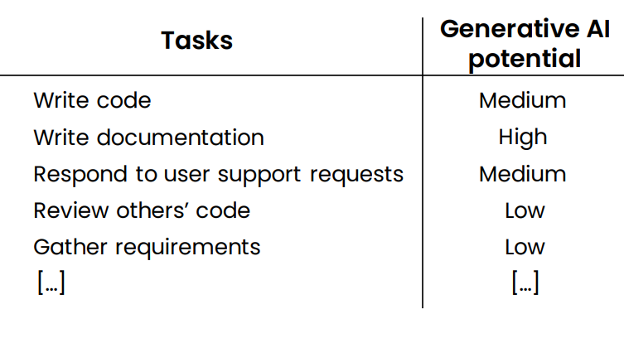
Computer programmer

Slide 4
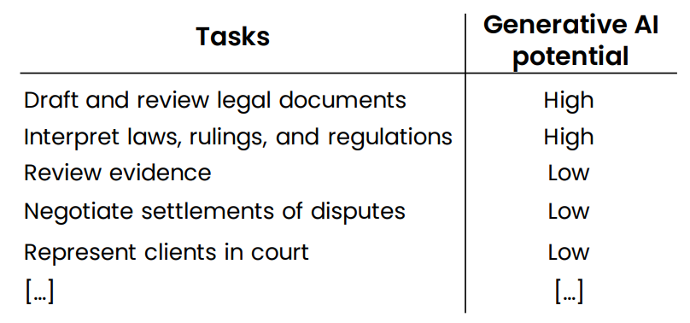
Lawyer

Slide 5
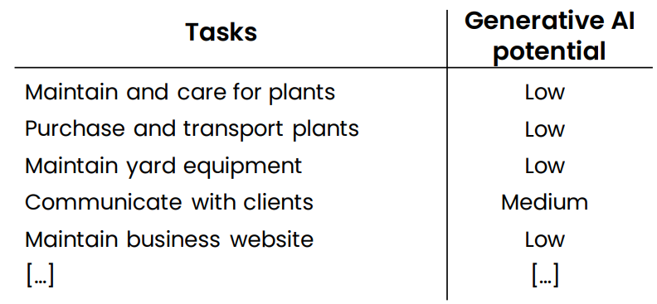
Landscaper

Slide 6
New workflows and new Opportunities

Slide 7
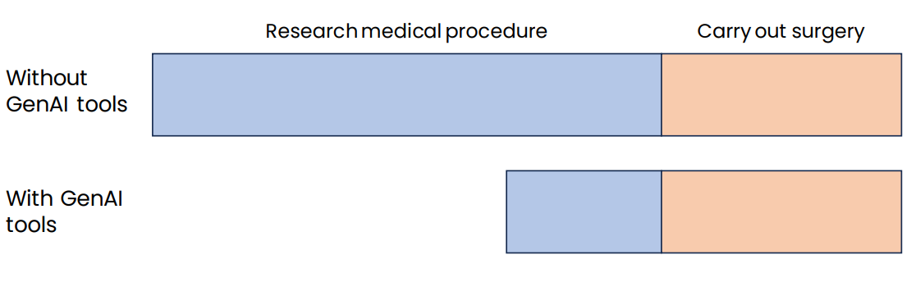
Example 1: Surgeon

Slide 8
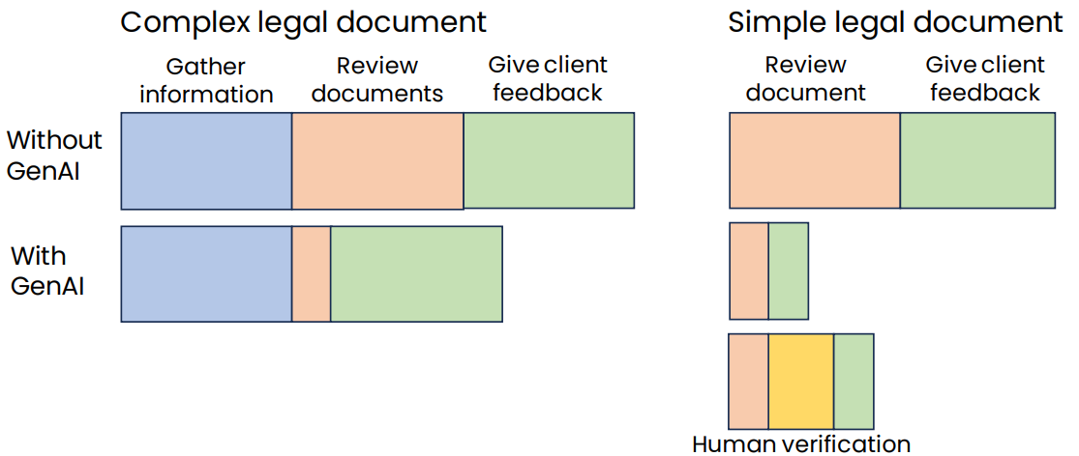
Example 2: Legal documentation review

Slide 9
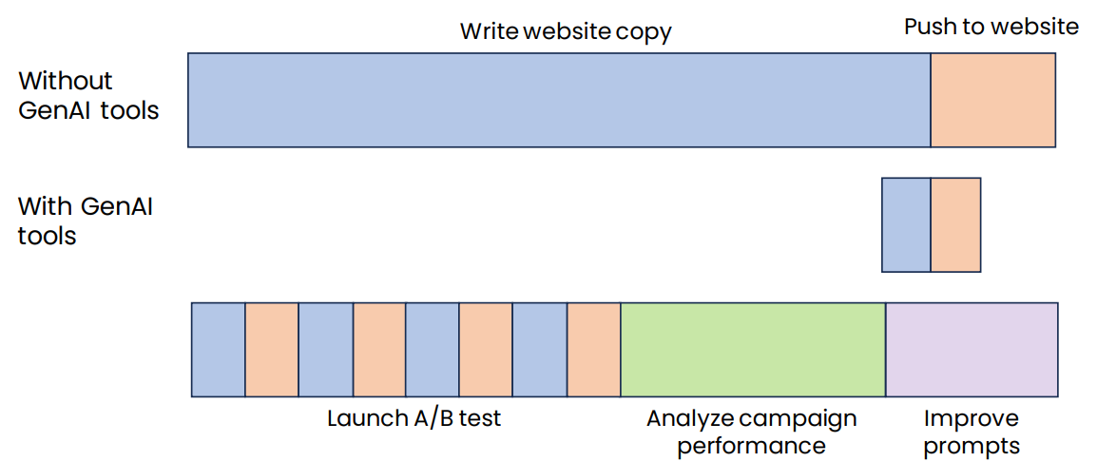
Example 3: Marketing automation

Slide 10
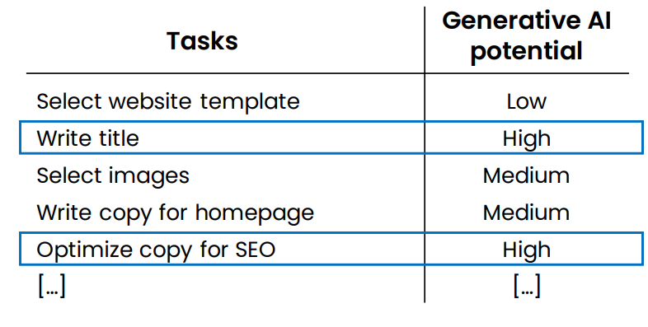
Example: Helping customers build websites

Slide 11
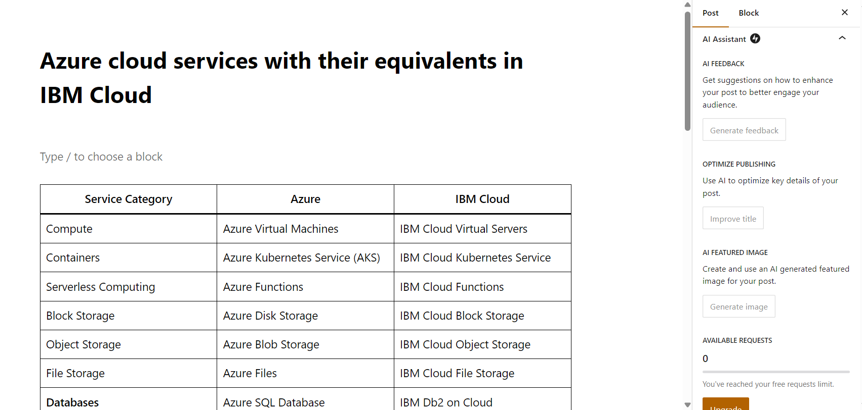
Wordpress AI Assitant

Slide 12
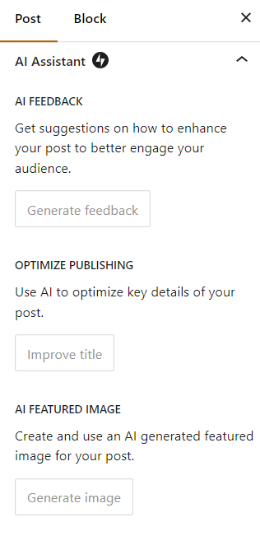
Wordpress AI Assitant

Slide 13
Summary
How generative AI works
What it can and cannot do
Common use cases: Writing, reading, chatting
Generative AI Projects
Lifecycle of a generative AI project
Technology options: Prompting, RAG, Fine-tuning
Implications on Business and Society
Analyzing tasks in jobs for automation or augmentation potential
Societal concerns, responsible AI

Slide 14


Q&A

